Slide 1
Transport of critically ill
Dr Udgeeth Thaker MD, IDCCM

Slide 2
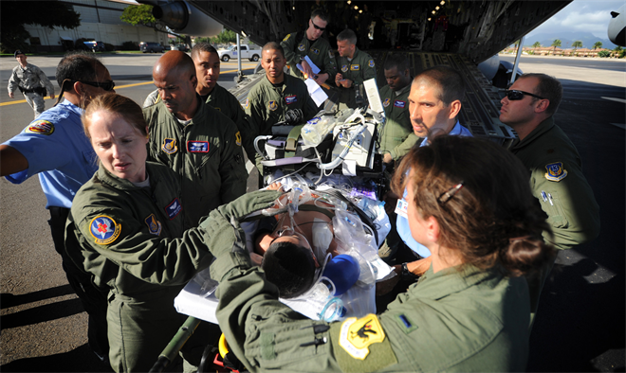

Slide 3

Transport : modes

Slide 4
Transport : types
Intrahospital
Within departments
For diagnostics
For
Surgery
For
Better treatment
Ward ←→ICU
Interhospital
For better care
Diagnostics

Slide 5

Transport: when ? Why?
More then 90% of brainstorming is for there two questions…
If we are able to answer these two questions … the last answer HOW ? Is minor thing

Slide 6

When & WHY ?
The decision to transport a critically ill patient, either within a hospital or to another facility, is based on an assessment of the potential benefits of transport weighed against the potential risks.
Critically ill patients are transported to alternate locations to obtain additional care, whether technical, cognitive, or procedural, that is not available at the existing location.

Slide 7

When and why ? No transport !!
If a diagnostic test or procedural intervention under consideration is unlikely to alter the management or outcome of that patient, then the need for transport must be questioned.
No benefit as compared to risks → no transport…

Slide 11
Guidelines
Guidelines are developed for various types of transport, and presented as such
(1) Intrahospital transport
(2) Interhospital (secondary) transport.
(3) Air Transport in Indian Conditions
(4) Medico legal aspects of transporting critically ill patients.
Supportive Documents :
(1) prehospital (primary) transport
(2) ambulance Specifications
(3)Equipment, Drugs and monitoring required during transport,
(4) training of personnel,
(5) Format for transport.

Slide 12
transport team :: escort
Ideally the patient should be accompanied by a physician along with the nurse looking after the patient
The patients moved by the specially trained transport team has a 15.5% overall complication rate, with 10.2% minor, 2.5% moderate (compensated for with medications), and 2.8% severe complications that did not respond to intervention. No medications or therapies were delayed, and only 2 patients (0.8%) had decompensation that required the examinations to be aborted. This was significantly better than the reported national complication rates for intrahospital transportation of patients
specially trained ICU transport team can substantially reduce the rate of adverse outcomes generated by the transportation of critically ill patients.

Slide 13
Pre-requisites for transport
Detailed history and examination
Detailed investigation
Discussion with relatives and explaining travel and risk
Check all requirements of the patient
Check all available things in the vehicle of travel
Check all facilities at receiving centre
Communication before and during transfer
Access readiness to handle adverse event in transit

Slide 14
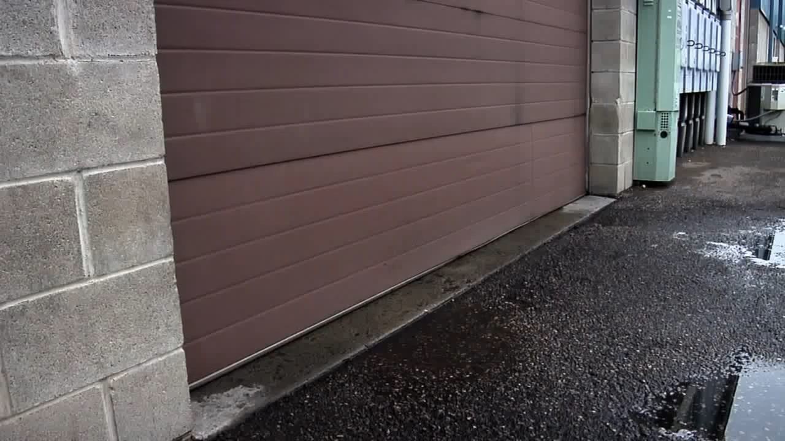
Video of professional transfer

Slide 15
It is a specific business :: a subset of intensive care
Most of the intensivist doing pvt practice have their transport team
These are specialized intensivists examines the patient, look over the reports, convince and counsels the relative , talk to the receiving facility and then decide the mode of transport and charges accordingly.
WHY? → High risk → high cost → limited resources
Chances of deteoritaing the patient are higher
Bridging both centres requires coordination.

Slide 16
Critical care transport
By Road
By train
By boat
By Helicopter
By Air ambulance [private jet]

Slide 17
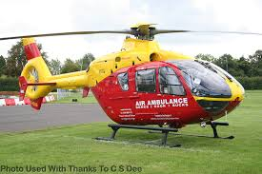

Slide 18
Air transfer :: selected subset of patient :: helicopter transfer
Helicopter transfer is very very “SHAKEEYYY”
Not suitable for critically ill as ventilation and oxygenation is a major problem
Possible to bring ET /TT out while on ventilator / ambu
No pressurized cabin available
SUITABLE to transfer from point of injury / incidence to hospital.
Possible to give primary care not tertiary health care.
Routinely seen[movies], less frequently used transport

Slide 19
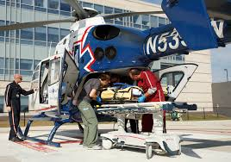

Slide 20
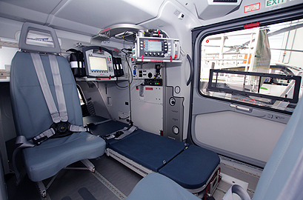

Slide 21
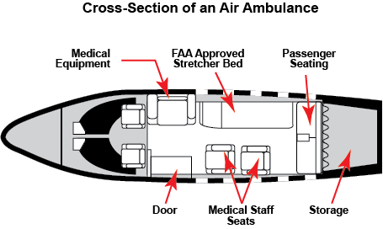

Slide 22
Air transfer : yes or no?
Not for the patient who are likely to detoriate → during transfer
Reduced time for transport significantly
The AIR AMBULANCES are smaller air craft → fly at low altitude → more time then routine air travel
They most of the time do not have pressurized AIR CABINS
  Not favourable for post surgical patients → decreased pressure of air
  Not favourable for respiratory conditions→ decreased o2

Slide 23
AIR transfer in passenger air craft
9 chairs are to removed, detached from passenger aircraft on booking 12 or more
And then patient can be transferred in FLOOR BED
With Ventilator and other life support…
Special permissions are required.
Dual transfer air fare is to be given for the escort.
Air base will give , ambulance, wheel chair facilities → no streacher.
Condition: Aircraft will not halt for patient during travel.
For passenger it will halt, considering risk to life.

Slide 24
Patient as passenger :: not allowed
Not allowed !!!!
No drugs are allowed in cabin IV
No syringes allowed
No IV line with patient is allowed
Patient with serious diseases are excluded before travel.
What is available
Air craft first AID kit contains emergency medicines only
Wheel chair assistance is available
Doctor on arrival is available.

Slide 25
Rail transport
Not available easily
Otherwise can be the most comfortable way of transfer of critically ill
All green signals
No restriction of facilities
No restriction of space
No restriction of pressure changes and traffic jam
Not available in india
Medical help coach is there which will go to rail disaster site and give first aid but they do not transfer patient through rail. [mostly]

Slide 26
Transport over water
Slow
No contact with base
Not favourable
Not used unless on island
Can take the ambulance on boat and transfer to the other side → Easy.

Slide 27
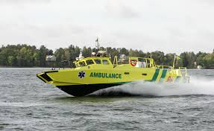

Slide 28
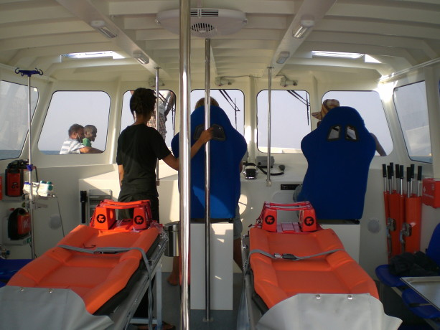
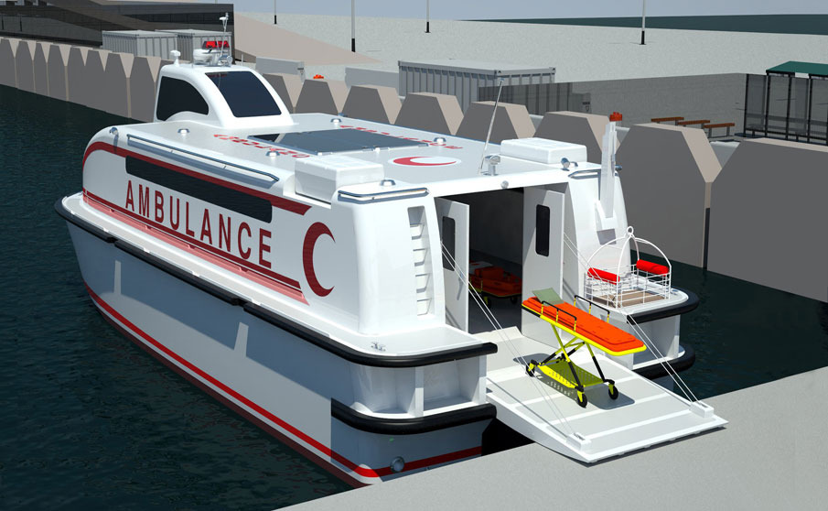

Slide 29
A life boat …

Slide 30
Ambulance :: on road
Advantage :
  Can stop for further treatment if patient detoriated
  Can stop for assistance
  can adjust with changes in schedule → very important
  Trained personnel → readily available

Slide 31
Ambulance :: on road
GPS tracking →advisable
Can transmit patient related data live to the receiving hospital
Have to communicate patient related condition intermittently with the receiving center.
Always better to have escort / transport team from receiving hospital .

Slide 32
Procedures on the way !! NO !!!
You cannot do skillful procedures during transport
Intubation → not possible
Central line →not possible
Even some times IV line insertion is not possible, even if ambulance is at halt. Because many other factors.

Slide 33
Cannot transport patient on niv
NIV cannot be maintained in transfer
Always intubate all ventilator patient and all high oxygen requirement patient before transfer.
Always prefer AMBU over BAINS.
Always prefer at least two IV lines or 1 central line
Always prefer SEDATION during transport but not paralysis .

Slide 34
Equipment in ambulance
Driver : skilled
Driver should known the road map to the destination
Full tank fuel
Lights and siren to be checked
Ambulance checklist to be followed.

Slide 35
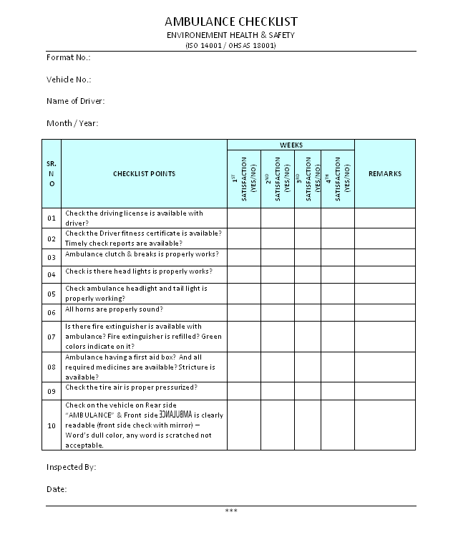

Slide 36
Equipment during transport
Equipment must be robust, lightweight, and battery powered.
All equipment should be dedicated for the purpose of transport and should not be used elsewhere.
The equipment requiring charging should be kept continuously charged with spare fully charged batteries available.
A designated person should be responsible to look after, check over the equipment periodically.
Drugs should be checked periodically for expiry and replaced immediately when expired or used for a patient.

Slide 41
Transport ventilator
Single tubing or double tubing
Oxygen callibration → best if available
Battery back up
Inverter charge → please3 check before starting
Secretions suction → must before leaving
Suction devices and catheters → must

Slide 42
Nutrition in transfer
Patient should be NBM before transfer. IF NOT>>>
If feed is to be given then you must carry
Slice, mazza, lassi, soup are available even on highways which can provide good nutrition on the way through RT.
If stool passed in travel ?? → can give RIDOL ??

Slide 43
MLC in transfer
If patient is having MLC and it is noted in Vadodara police station , it will be still in judicial range of Vadodara till XYZ police station is informed again on reaching the destination .
If MLC patient expired during transport, then the vehicle has to stop in the near by district place and get the PM done. After that only the body can be handed over to relatives.

Slide 44
